Slide 1





1
2
3
4
5
Data Acquisition
Data Modelling
Data Manipulation
Exploratory Data Analysis
Data Visualization
Customer Purchase Behavior Analysis
Moonmoon Samal (Cap_Ds_05)

Slide 2





1 Data Ingestion
2 Data cleaning
3 Reading Dataset
4 Data Handling
5 Advanced Analysis
DATA ANALYSIS (SQL)
Customer Purchase Behavior Analysis

Slide 3





DATA ACQUISITION
DATA NORMALIZATION
Identified duplicate customer IDs and product IDs during data ingestion.
Applied 3rd Normal Form (3NF) normalization to eliminate data redundancy and divided cleaned table into 3 separate table to Improved data integrity and reduced data storage
DATA CLEANING
Cleaned data using SQL CTE (Common Table Expression) to address duplicates and use Update, WHERE ,Insert clause to handle noisy values in other column.
ADVANCED ANALYSIS
Leveraged normalized tables to perform efficient aggregations using SQL functions:

Slide 4
AFTER CLEANING
Transaction ID | Customer ID | Customer Name | Product ID | Product Name
1 | 101 | Victoria Larson | 200 | Coffee Maker
2 | 102 | Mary Chavez | 201 | Smartwatch
3 | 103 | Ronald Brandt | 202 | Tablet
4 | 104 | Richard Joseph | 203 | Blender
customer purchase information for an online retail company

Slide 5
CUSTOMER PURCHASE BEHAVIOR ANALYSIS
Product Category | PurchasePrice | Purchasequantity | Purchasedate | Country
Eloctronics | 689.99 | 1 | 03-01-2024 | Barbados
Home Appilance | 79.27 | 5 | 26-01-2024 | Nambia
Eloctronics | 666.75 | 3 | 05-06-2023 | Tajikstan
Home Appilance | 316.19 | 4 | 08-12-2023 | Srilanka
customer purchase information for an online retail company

Slide 6
NUMBER OF CUSTOMERS PER COUNTRY
TOTAL SALES PER PRODUCT
ADVANCE ANALYSIS
select p.productid, p.productname, sum(pur.purchasequantity * pur.purchaseprice) as total_sales
from products p
join purchases pur on p.productid = pur.productid
group by p.productid, p.productname
order by total_sales desc;
select country, count(*) as num_of_customers
from customers
group by country
order by num_of_customers desc;
SQL
AVERAGE PURCHASE PRICE PER PRODUCT
TOP 5 PRODUCTS
select p.productname, sum(ps.purchasequantity) as total_sales
from products p
join purchases ps on p.productid = ps.productid
group by p.productname
order by total_sales desc
limit 5;
select p.productname, avg(pur.purchaseprice) as avg_purchase_price
from products p
join purchases pur on p.productid = pur.productid
group by p.productname
order by avg_purchase_price desc;
5
SQL Advance Analysis After Normalisation

Slide 7


DATA ANALYSIS (PYTHON)
Customer Purchase Behavior Analysis
2
Pymysql+sqlalchemy
4
Data Overview
1
Connecting SQL to Python
3
Importing Libraries
5
EDA

Slide 8
JUPYTER NOTEBOOK
B |  | C | Total Revenue 1485760.549
D | Avg.Purchase value 489.29 | M | Customer Behaviour 877-customerid with 999.98 total_spent
O | December-2023 Highest purchase quality- 295 unit | Q | Lowest is jun -2023 with 28 unit
U | 2023-Highest Revenue-$262,346.07 | # | Top Performing products are Electronics- 248,194.56 Revenue
Total Purchases
3053
Used libraries for data analysis.
Performed exploratory data analysis (EDA).
Analyzed customer behavior and purchase trends.
Identified top performers (customers and product categories).
Emphasizes the overall goal of gaining insights from clean data.

Slide 9


DATA ANALYSIS(POWER BI)
Customer Purchase Behavior Analysis
1
Connecting SQL tp PowerBI
2
ETL
3
Creating New measure
4
Data Visualisation
5
Matrix & Dashboard

Slide 10

KEY REPORT
Customer Purchase Behaviour

Slide 11

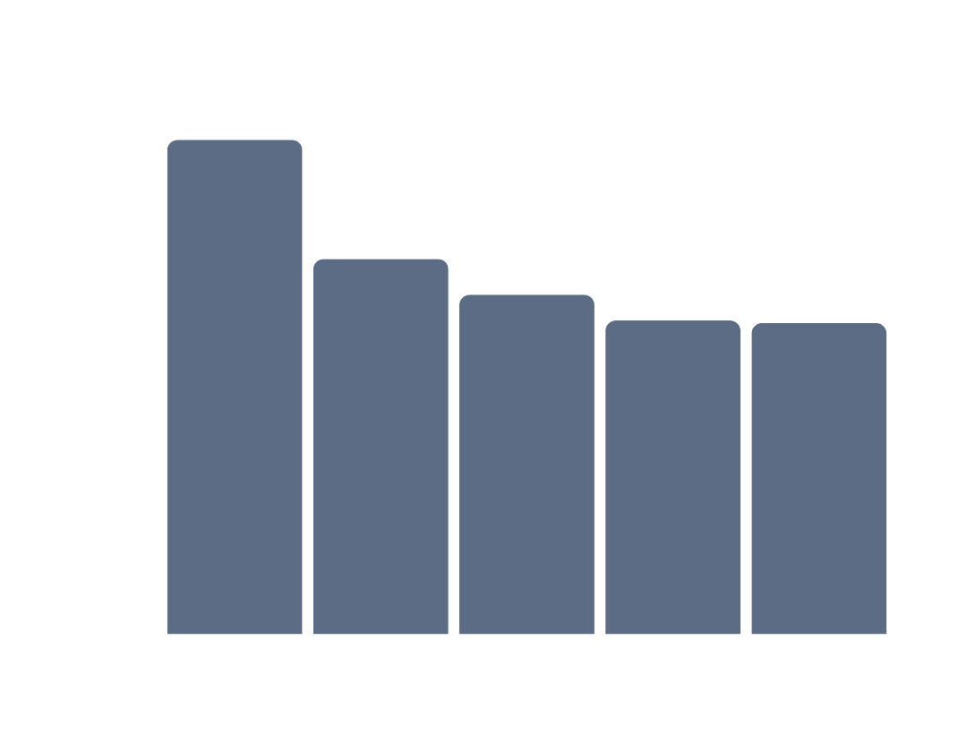

KEY REPORT
TOP CUSTOMER
Total Revenue
1M
CUSTOMER PURCHASE BEHAVIOUR ANALYSISI
As per Total_purchase
Total Spent
489K
Avg. Purchase
489.29

Slide 12
CONCLUSION
1. Total Purchases: 3053
2. Total Revenue: 1,485,760.54
3. Average Purchase Value: 489.29
Purchases trend over time:
Monthly Trend in 2023:
December-2023 saw the highest purchase quantity (295 units) , purchase price of 51910.42, with an average purchase value of 175.96.
and lowest is the jun-2023 with the purchase quantity(28 unit) , purchase price of 4012.44 with an avg purchase value of 143.30
Purchases showed fluctuations across other months, indicating seasonal variations or promotional effects.
Quarterly Trend:
Q2 2023 had the lowest purchase quantity but a moderate average purchase value.
Q3 and Q4 2023 showed higher quantities and revenues
Q1 2024 maintained a steady purchase quantity and average purchase value.
Yearly Trend:
2023 saw the highest overall purchase quantity (1,651 units) and revenue ($262,346.07), with a consistent average purchase value.
2024 started slightly lower but maintained a strong average purchase value.
Top performing product Performance:
Electronics: Customers made 1,480 purchases, generating 248,194.56 in revenue. On average, each purchase in this category was about 167.70.
Home Appliances:This category saw 1573 purchases, totaling 241,080.16 in revenue. The average purchase here was around 153.26.

